Slide 1
Decentralized Social Security
Blockchain UAE GovHack

Slide 2
Goal
Provide a very simple model for a basic social security insurance, based on small groups
Seldom, but severe events (death of a family member, lethal illness, but maybe also divorce and unemployment) are insured
Small premiums, optimized CIR (Cost-Income-Ratio)
Insured events a such that the fact of the event can be checked easily by distributed claims agents, who get a small fee for assuring a claim
Advantage for users: Direct and unbureaucratic help in disastrous situations
Advantage for governement: Sustainable relief for state systems especially for small claims.

Slide 3
Basic Idea
People form Groups of max. 12, groups form meta-groups etc. up to 4-6 levels (max. participants between 20K – 3M)
Levels correspond to social entities, e.g. family, neighborhood, village, town …
Participants pay a small premium of e.g. 2$ monthly in a local pool.
Incoming premiums are equally distributed over the levels, i.e. in case of 4 levels, a quarter is kept in the local pool, a quarter in the pool one level up, a quarter in the 3rd level pool, and the rest in the top pool.
An (optional) reinsurance or governmental guarantee covers the excessive risks.

Slide 4
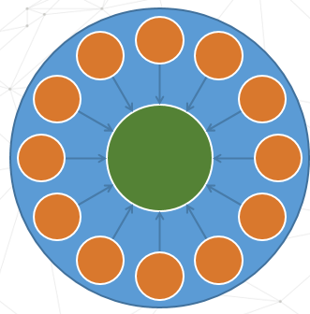
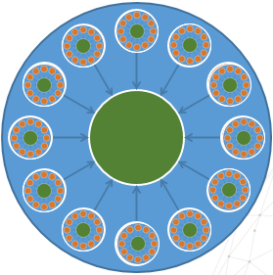
Basic Idea
…

Slide 5
Collected premiums
Participants: | 12x12x12x12= | 20736
Premium: |  | 2 | $
Premium p.m. |  | 41472 | $
 | First level |  | Second level |  | Third level |  | Top level | All levels
 | Single pool | Sum | Single pool | Sum | Single pool | Sum | Sum | Sum
January | 24 | 20736 | 288 | 10368 | 3456 | 5184 | 5184 | 41472
February | 48 | 41472 | 576 | 20736 | 6912 | 10368 | 10368 | 82944
March | 72 | 62208 | 864 | 31104 | 10368 | 15552 | 15552 | 124416
April | 96 | 82944 | 1152 | 41472 | 13824 | 20736 | 20736 | 165888
May | 120 | 103680 | 1440 | 51840 | 17280 | 25920 | 25920 | 207360
June | 144 | 124416 | 1728 | 62208 | 20736 | 31104 | 31104 | 248832
July | 168 | 145152 | 2016 | 72576 | 24192 | 36288 | 36288 | 290304
August | 192 | 165888 | 2304 | 82944 | 27648 | 41472 | 41472 | 331776
September | 216 | 186624 | 2592 | 93312 | 31104 | 46656 | 46656 | 373248
October | 240 | 207360 | 2880 | 103680 | 34560 | 51840 | 51840 | 414720
November | 264 | 228096 | 3168 | 114048 | 38016 | 57024 | 57024 | 456192
December | 288 | 248832 | 3456 | 124416 | 41472 | 62208 | 62208 | 497664

Slide 6
Claims management
We calculate with a average probability of default of 1%, i.e. risks are defined in a way that this probability is reached.
Average payout can be e.g. 50x annual premium, i.e. something around 1,000-1,500$
Rest of premiums are operational costs and fees for claims agents
Claims agents are certified people with high reputations, e.g. physicians, mayor, pharmacist
At 20.000 participants, there will be in the average 200 claims per year, this number can be further reduced by paying out 50% of the claims without check
Funds unused for claims reduce the premiums in the following year.
10% OpCost
30% Reserve Fund
Premium
60% Claims

Slide 7
Reserve Fund
30% of the premiums are kept in a reserve fund
The reserve fund is filled up over 4-5 years.
A fully donated reserve fund will lead to decreased reinsurance premiums.
After filling up the reserve fund, there are three options:
increase payouts on claims
decrease premiums
or both, up to 30% (the amount deducted from premiums to fill up the reserve fund).

Slide 8
Scalability
With a single contract, the system can scale up to 6 levels, with up to 3M participants. Under realistic assumptions, we will have an exhaustion of e.g. 80-85% per level, leading to ca. 1M participants.
If properly designed, the systems has an extremly high resilience, i.e. it runs (mostly) without active management,

Slide 9
Outlook
In the design presented, funds are kept in the pools without active fund management, no return on investment is expected (and needed).
In an extended design, funds could be used e.g. for micro financing.

Slide 10
Prototype
The prototype shows:
How to register with the system (we suppose that strong identity solutions will exist in the near future, for example uPort)
How to form groups We start with a „seed structure“ of 4 levels and 2 groups on each level, where the top 3 levels are given (7 groups)
How to pay premiums (that‘s really simple!)
How to claim.

Slide 11
What we expect from government
The system will grow by word of mouth, but in the starting phase, it will need some seed funding for basic marketing, setup, education of claims agents …
It would be a good idea if the government would issue some kind of guarantee or pay the reinsurance fees for a starting period.

